Slide 1
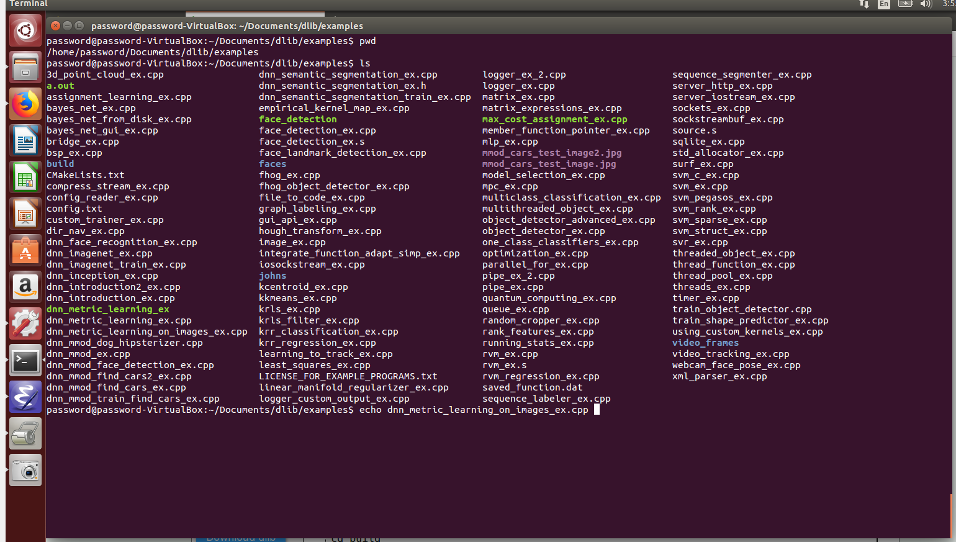
1. Choose File (From Dlib C++ Library)

Slide 2
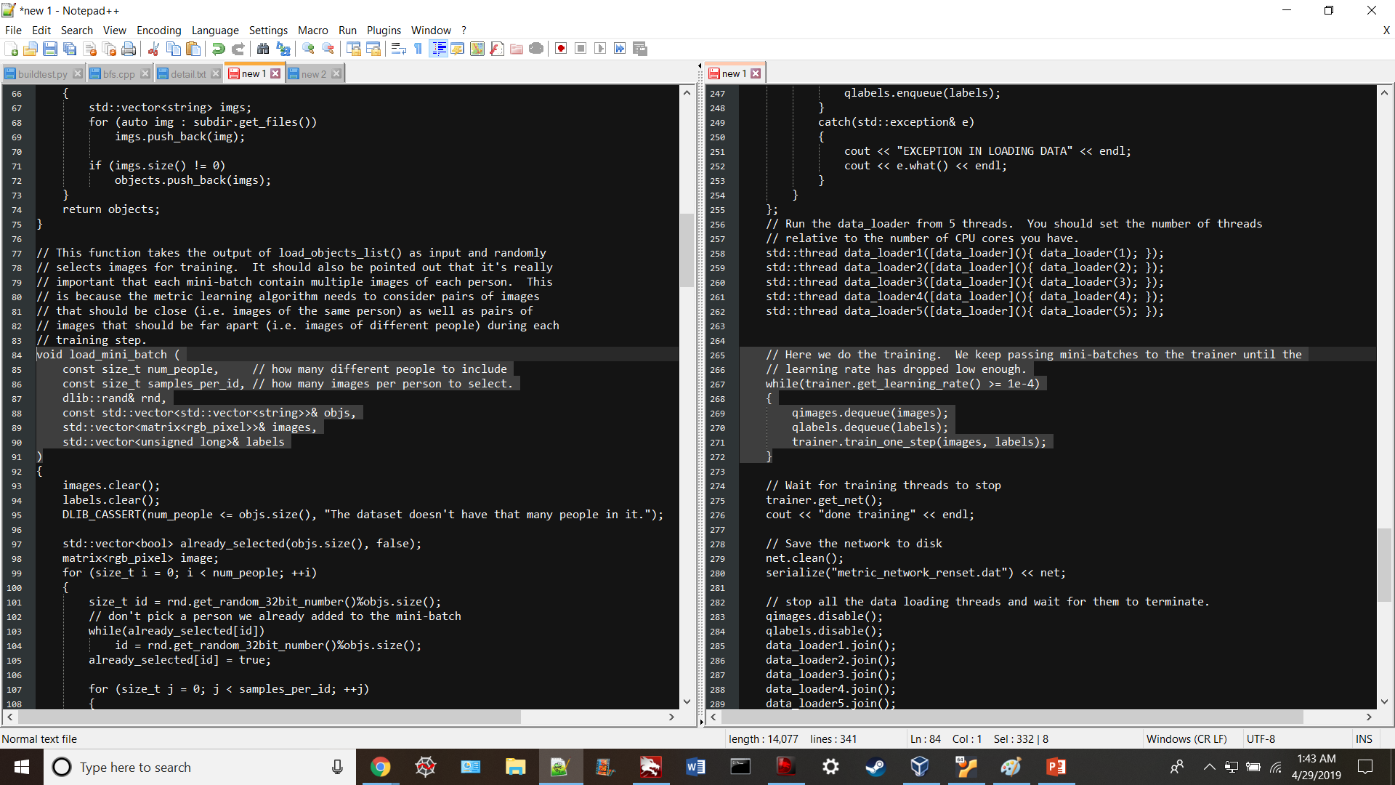
2. Isolate C++ Code that does Matrix Ops

Slide 3
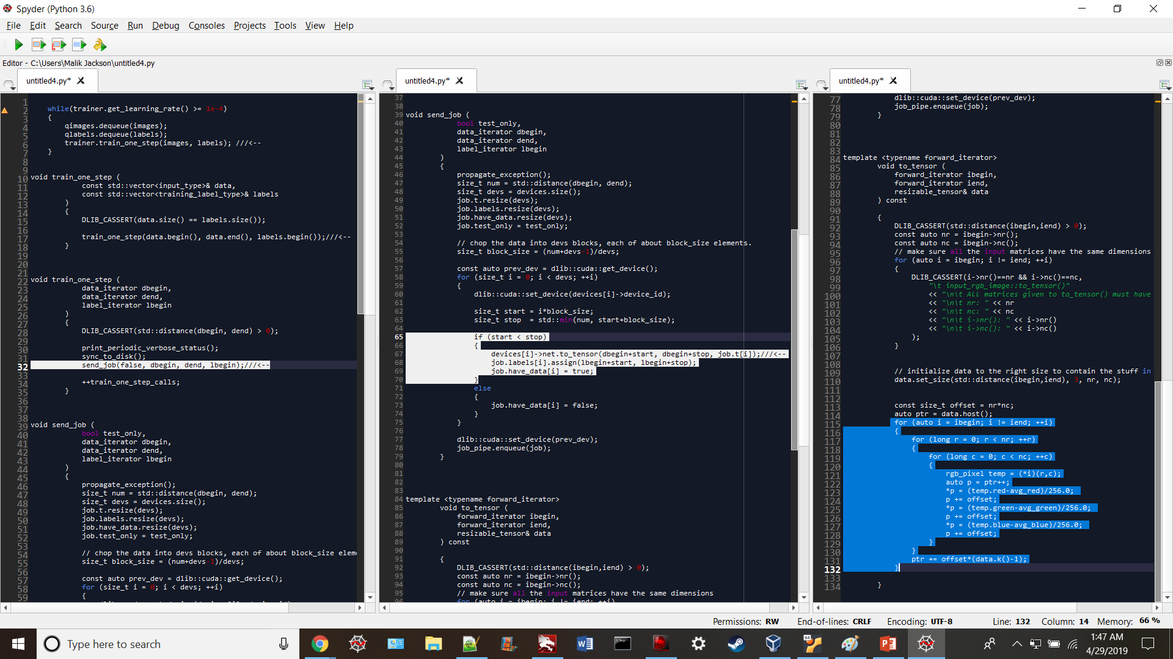
2. Isolate C++ Cont.

Slide 4
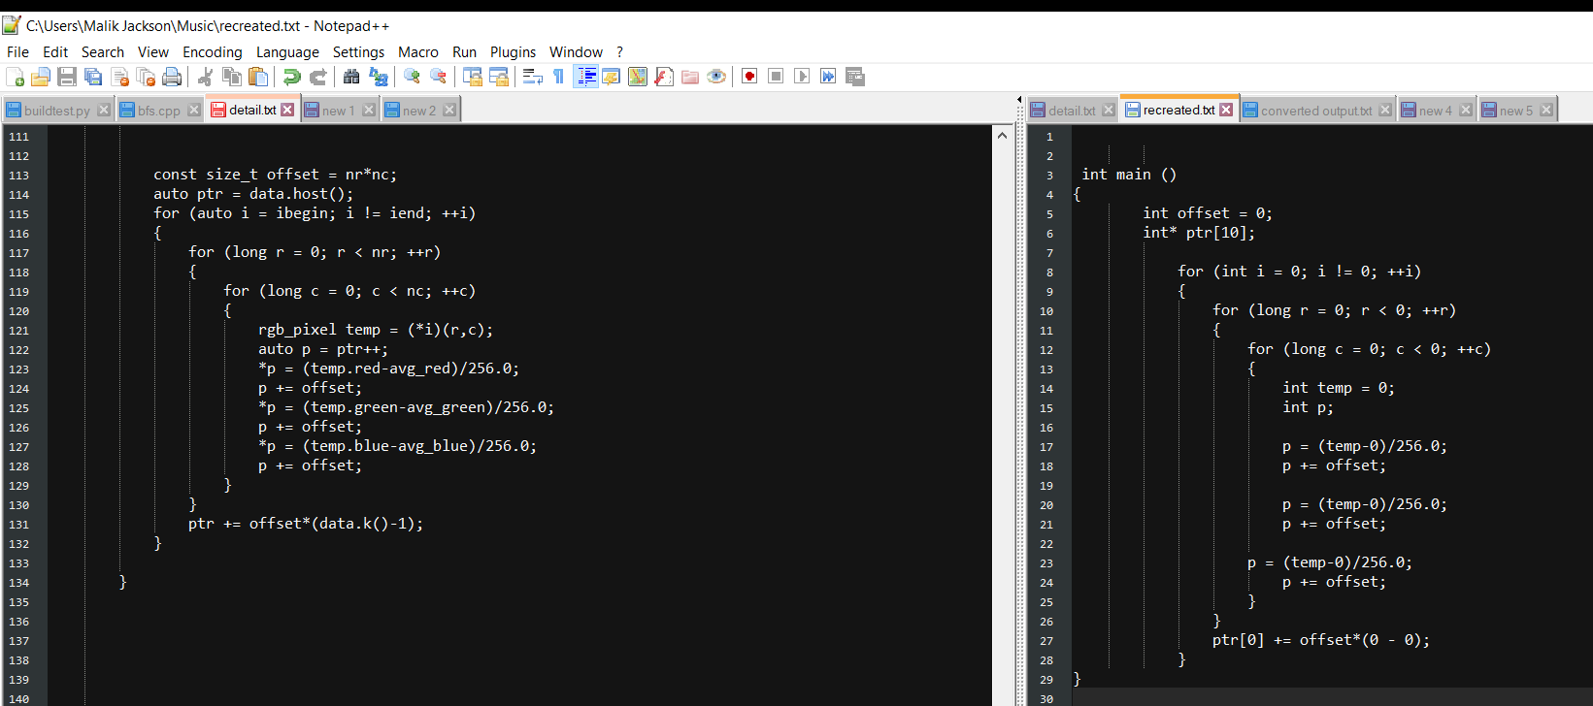
3. Compartmentalize and create simplified representative C++ code

Slide 5
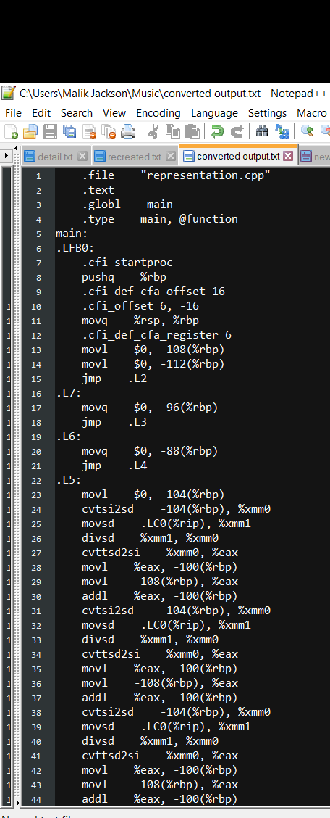
4. Convert to Assembly (x86-64 gcc 4.8.4)

